Slide 1



Slide 2
What is functional programming?
Imperative languages – sequence of commands executed one after each other.
Functional language – single expression, executed by evaluating expression

Slide 3
Why use functional programming?
It can increase programmer productivity
Shorter clearer more maintainable code
Fewer errors, higher reliability

Slide 4
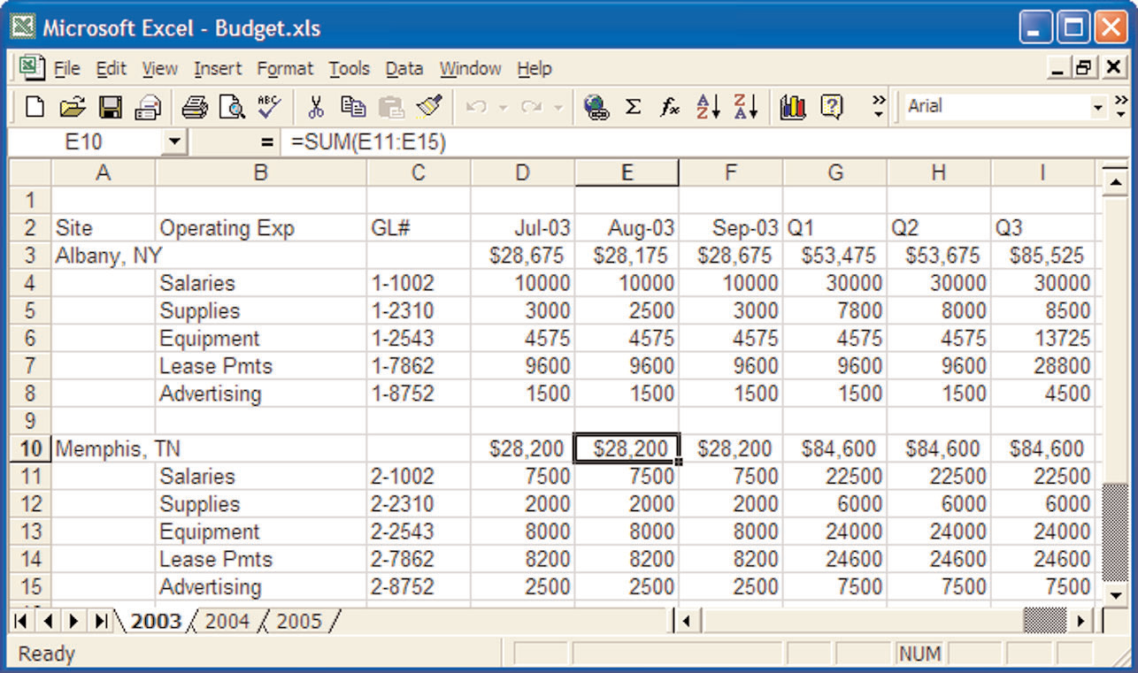
What is functional programming?
Like spreadsheet, focus is on what to be computed not how:
  No order specified
  No memory allocated

Slide 5
What is functional programming?
Another nearly functional language is SQL – gets information from a database but does not tell you how.

Slide 6
What is good about functional programming?
Ease of understanding
More concise
Code reuse
Built in memory management

Slide 7
Who uses functional programming?
Software AG, a major German software company, use it in an expert system (Natural Expert)
Ericsson use it in telephony applications
ICAD Inc use it in a CAD system for mechanical and aeronautical engineers.

Slide 8
What is Haskell?
It is designed to handle a wide range of applications, from numerical through to symbolic.
There are a number of compilers and interpreters. All are free.
We will use Hugs.

Slide 9
What is Haskell?
A functional language (that is, everything is done with function calls)
Types are checked by the compiler, but you don't have to declare them
A lazy (nothing is done until it needs to be) language

Slide 10

Calculate Factorial of n
Haskell
C
  int Factorial (int n)
  {
  if (n==1) || (n==0)
  return 1
  else
  return n*Factorial(n-1);
  }

Slide 11
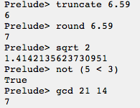
Calling functions (in-built or user-defined)
Calling functions is done by putting the arguments directly after the function. There are no parentheses as part of the function call:

Slide 12
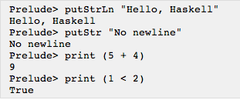


What is Haskell?
I/O functions can be used to read from and write to the console. Some common ones include:

Slide 13
What is Haskell?
Write Haskell code that asks the user to input a number, reads a number in from the console, calculates half of the number and prints out “The answer is X” where X is the inputted number halved.

Slide 14
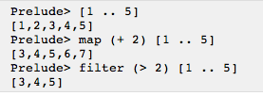
What is Haskell?
Lists are used a lot in Haskell. There are several functions that do nice things with them.

Slide 15

What is Haskell?
Factorial in Haskell:
Using this as a basis:
  Write Power Haskell code
  Write Fibonacci Haskell code
  Write GCD Haskell code
Notes:
fib 0 = 0
fib 1 = 1
fib n = fib (n-1) + fib (n-2)
gcd a 0 = a
gcd a b = gcd b y
where y = mod a b
Power x 0 = 1
Power x y = x*power x z
where z = y-1

Slide 16
Reference
http://www.haskell.org/haskellwiki/Introduction#Why_use_Haskell.3F
http://www.haskell.org/haskellwiki/Learn_Haskell_in_10_minutes

Slide 17
Thank You !

